Slide 1
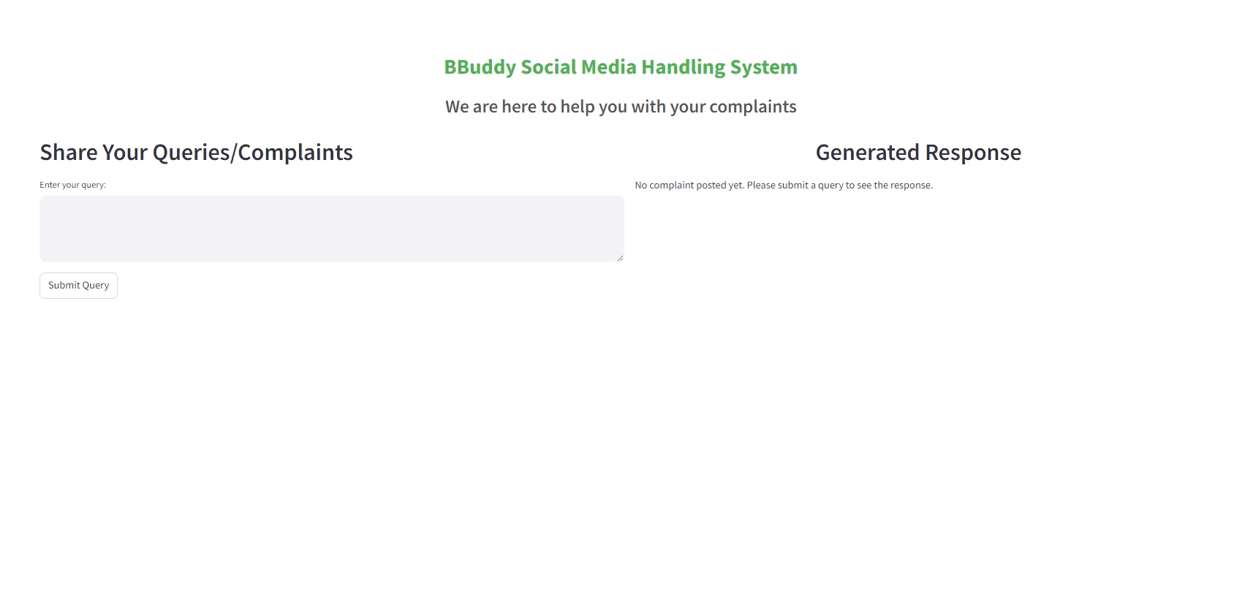
Customer querying for job opportunity

Slide 2
Negative feedback

Slide 3
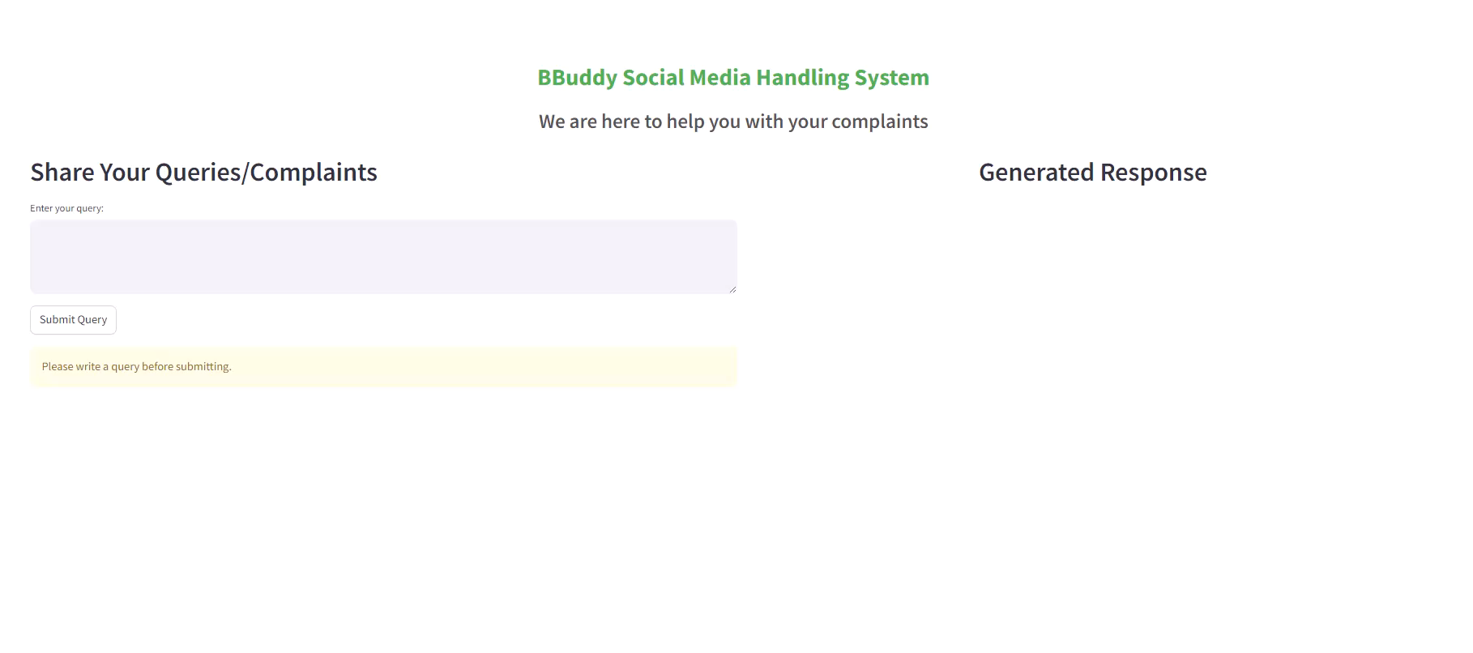
Issue with links

Slide 4
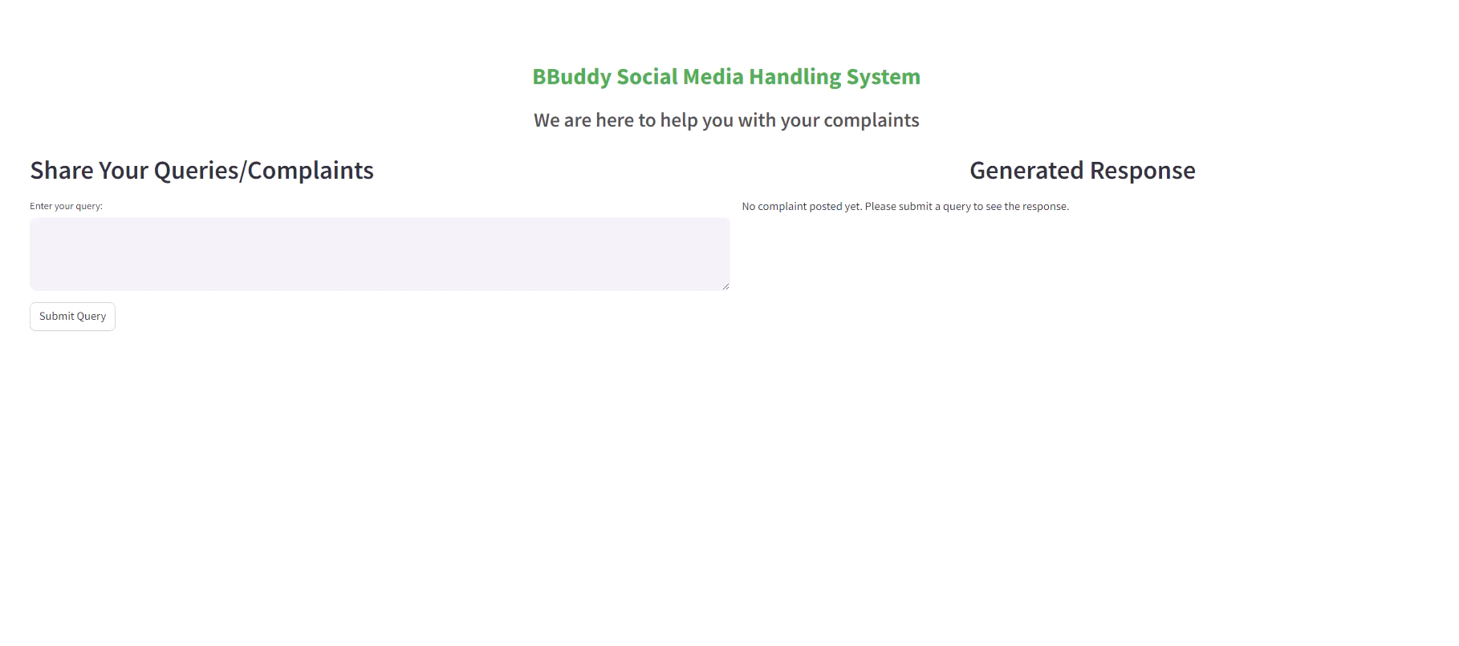
Customer complaint regarding transactions

